Slide 1
Question 7 (a) [5 marks] (2007 Exam )
In two dimensions, we perform a shear [shearing angle 45 degrees] by means of forces parallel to an axis which makes an angle of 30 degrees with respect to the positive x-axis
Given
vector

Slide 2
Question 7 (a) [5 marks] (2007 Exam )
In two dimensions, we perform a shear [shearing angle 45 degrees] by means of forces parallel to an axis which makes an angle of 30 degrees with respect to the positive x-axis. Find the final location of the point which was originally at (0,1)
Rotate clockwise 30=
Shear
parallel to x axis
Rotate anti clockwise 30=

Slide 3
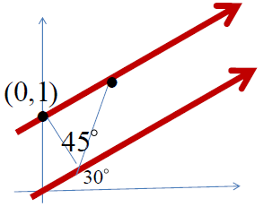
Rotate
clockwise
Shear
parallel to x axis
Rotate
anticlockwise

Slide 4
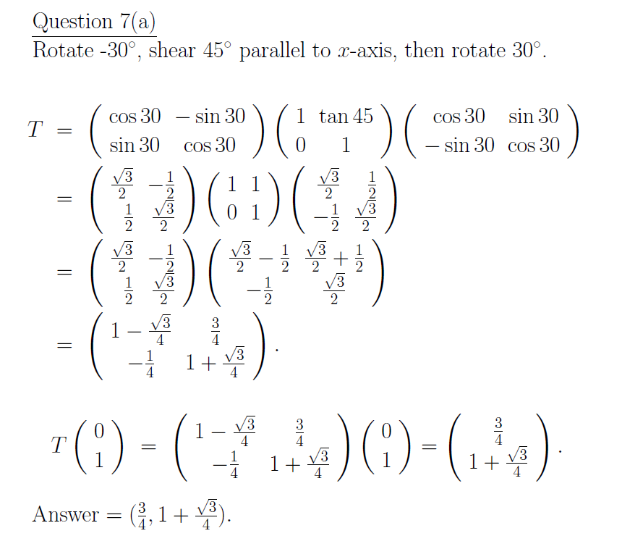
3rd action
2nd action
1st action

